Slide 1
Research Into Extending the Human Lifespan
Ariel Carino Ezra Sims Spencer Castillo

Slide 2
Aging
One of the main factors contributing to the aging process is the deterioration of the regenerative qualities found in most bodily tissues.
Body becomes more susceptible to disease

Slide 3
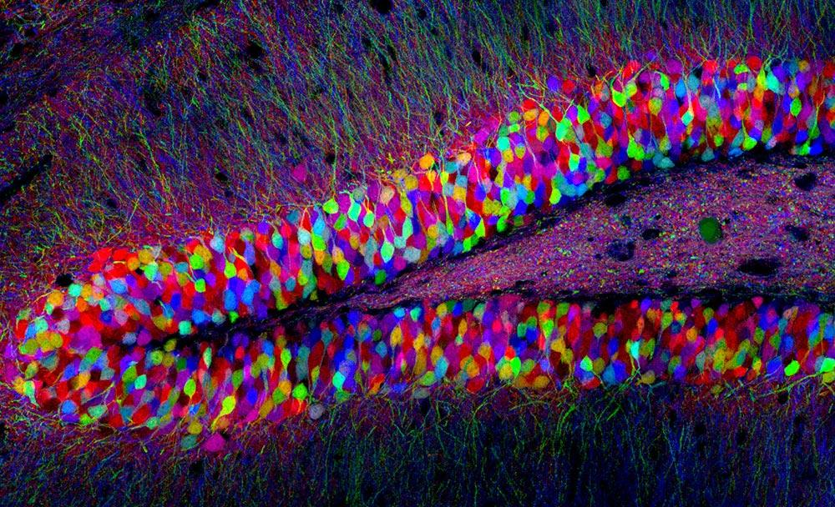
Heterochronic Parabiosis
2014 Dr. Tony Wyss-Coray and Dr. Saul Villeda experimented with mice and plasma.
New plasma-related opportunities

Slide 4
Could it be as simple as a pill?
Rapamycin- Regulates enzyme mTOR
Metformin-Diabetes drug shown to increase lifespan of mice

Slide 5
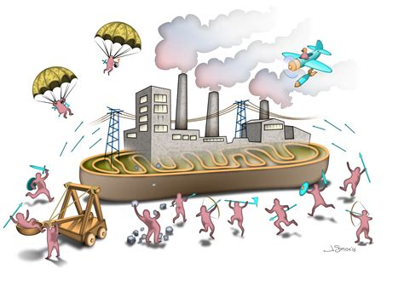
Mitochondria Replacement
UCLA’s biology department experimented with fruit flies to see the effects of replacing mitochondria
Broke apart enlarged mitochondria into smaller pieces via protein Drp1, then removed by Atg1 gene
Females lived an average of 20% longer
Males averaged 12% longer

Slide 6
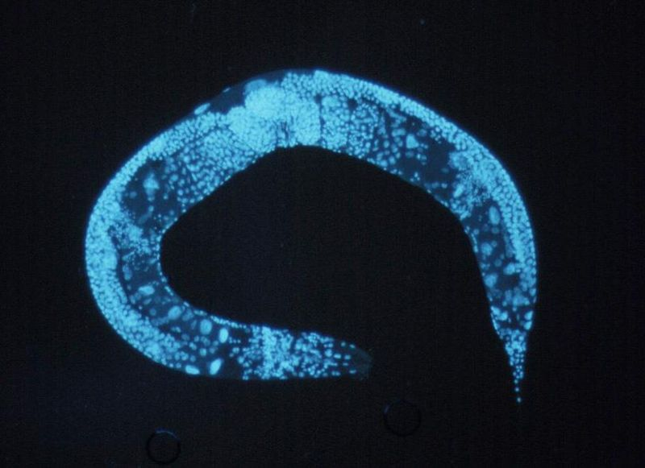
C. Elegans Worm
Similar reproductive/lifespan patterns as humans
SET-26 gene key to lifespan of worms
Disabling SET-26 → 3 day addition to the 2-3 week lifespan

Slide 7
Pros: Extension of human life
More time to spend with friends and family
Opportunities to travel and see different parts of the world
More time to spend in retirement
More time to acquire the knowledge and experience to operate effectively in the world
Increase in our standard living

Slide 8
Raise Human Productivity
Most humans spend a lot of time trying to find a purpose in life that makes them useful to society. Some humans find that purpose later in life and can only contribute to society for so long before they slow down. Yale economist William Nordhous, for example, claims that the dramatic increase in human life expectancy since 1900 has been responsible for about half the increase in our standard of living.

Slide 9
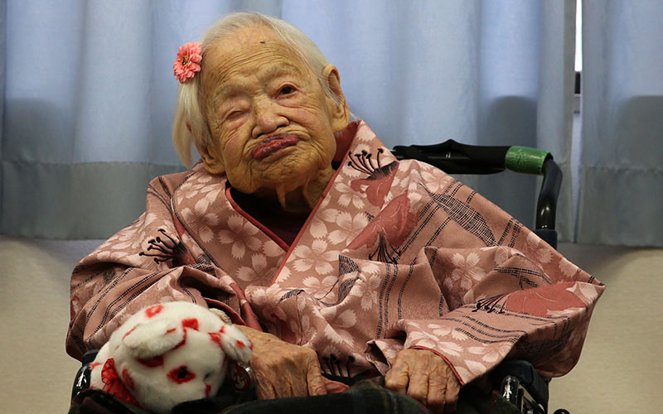
Cons: Extension of Human Lifespan
What are the risks?
Nabi Tajima

Slide 10
Overview
Overpopulation
Access to the population
Psychological Well-being
Cost of the treatment
Morality

Slide 11
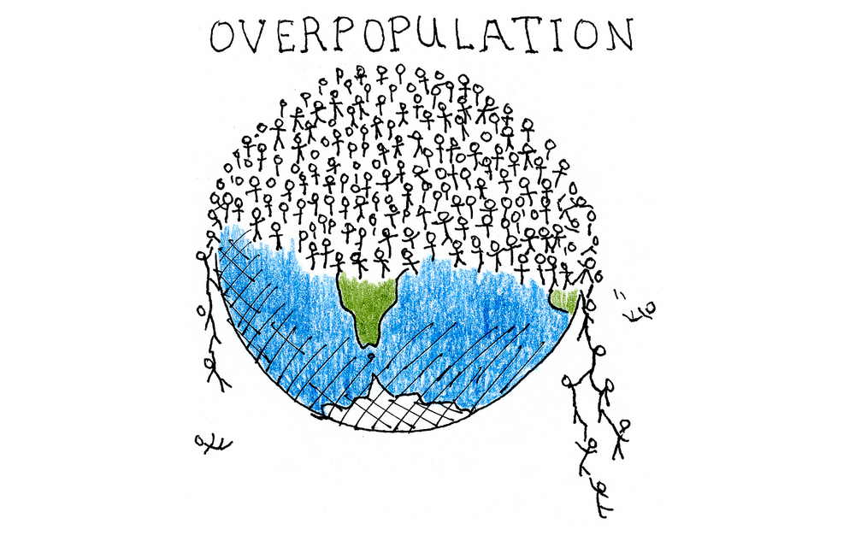
Overpopulation
Definition
the condition of having a population so dense as to cause environmental deterioration, an impaired quality of life, or a population crash
Too many babies are being born
Why does it affect the extension of human lifespan?
Scientists cannot predict how many people will continue to exist
How can it affect us as humans?
Humans can inevitably run out of resources
Is human overpopulation inevitable?
Vaccines

Slide 12
Access to the population
Who gets to test or use this type of treatment?
Will only certain individuals get access
Where will this treatment start off?
Can it be globally produced and trained
Will this treatment be limited?

Slide 13
Psychological Well-Being
How will we, as human beings, cope with the idea of living forever?
Mental health
Aging
How will the risk of diseases affect us?

Slide 14
Cost of this treatment
How much has this treatment will cost?
SENS Research Foundation
Forever Healthy Foundation
What major corporation will patent the final treatment/drug

Slide 15
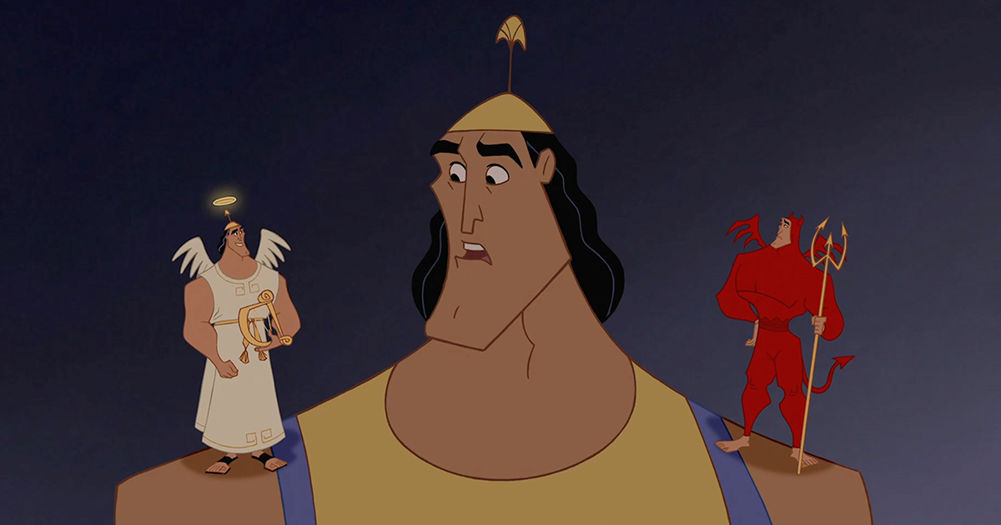
Morality
How will this affect people with beliefs surrounding death?
The heavens
Will people accept this type of treatment/drug?
The process
possible side effects

Slide 16
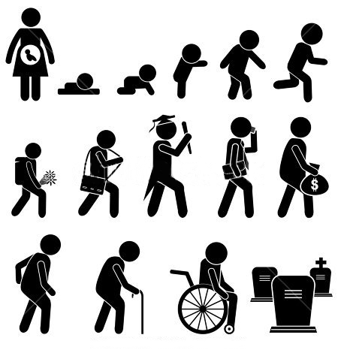
Conclusion
A disease or Natural
Death
Access
Cost
Limitation

Slide 17
References
Marko Kovic, Adrian Raucheisch, and Christian Caspar (2018): Killing death:Some implications of extending human lifespan indefinitely.ZIPAR Discussion Paper Series. Zurich, Switzerland.
John Harris and Sùren Holm The Institute of Medicine, Law and Bioethics, School of Law, University of Manchester, UK Journal of Medicine and Philosophy 0360-5310/02/2703-355 2002, Vol. 27, No. 3, pp. 355±368
http://www.alkahest.com/science/the-role-of-blood-factors/
http://www.sens.org/videos/one-one-investigative-interview-aubrey-de-grey
http://cornellsun.com/2018/02/13/gene-in-worms-could-be-key-to-longer-human-lifespan/
https://www.webmd.com/special-reports/anti-aging-science/20170329/anti-aging-pill
(Gerontological Society of America 2004, Vol. 59A, No. 6, 554–559)

